Slide 1
Creative and Effective Marketing
What is creativity?

Slide 2
Creative exercise
Warm up exercise:
Twist your arm without twisting your arm – from palms down to palms up.
5 min.
- groups of 2-3

Slide 4
Questions regarding creativity
? How and when do I get ideas?
? How can I capture ideas (remember them)?
? Can I train my creativity?
? What are the barriers to creativity?
? How can I remove those barriers?
? How does the brain work when I’m creative?
? Can we measure creativity?
? Is creativity and innovation the same?
? Are people on drugs more creative?

Slide 5
What is creativity?
Creativity
Creō: to create, make, give birth to… (ideas, things…)
“the ability to produce or use original and unusual ideas”
Cambridge dictionary

Slide 6
What is creativity?
“Creativity = unlimited use of knowledge”
Source: Byrge & Hansen, “Enhancing creativity for individuals, groups and organizations: Creativity as the Unlimited Application of Knowledge”

Slide 7
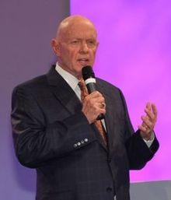
What is creativity?
”All things
are created twice:
Mental creation (idea)
Physical creation
(Stephen Covey)

Slide 8
What is creativity?
”Everything can be changed…”
Because we made it – we built it on an idea.
Develop or change that idea – you change the world.

Slide 9
What is creativity?
Creative confidence
Tom and David Kelley
Stanford d.school, IDEO, design thinking
Building creative confidence: https://youtu.be/4BO8Bj9Ek-g
Albert Bandura
Self-efficacy ”the sense that you can change the world, and attain what you set out to do”
Source:
Video: https://youtu.be/16p9YRF0l-g
PDF: Creative Confidence - pre and intro
PDF: HBR, Reclaim your Creative Confidence

Slide 10
”This world is but a canvas for your imagination”
Henry David Thoreau

Slide 11
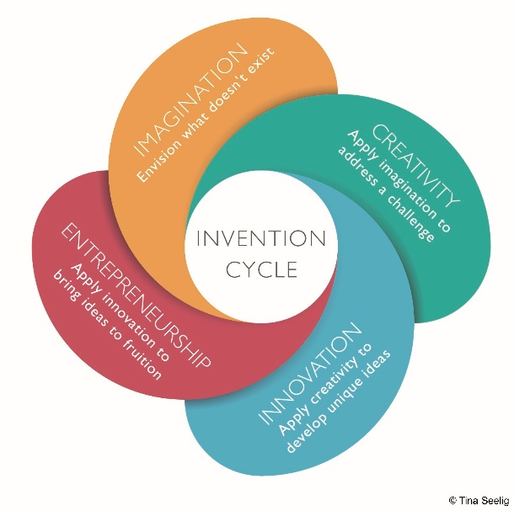
What is creativity?
What is the relation between:
Imagination
Creativity
Innovation
Entrepreneurship
One leads to the other…
Source: Tina Seeling, insight out - next slide for larger image

Slide 12
Notes:
Imagine that you can fly
Creating all sorts of creative solutions
Innovating a way to fly that there is a market for
Starting a business

Slide 13
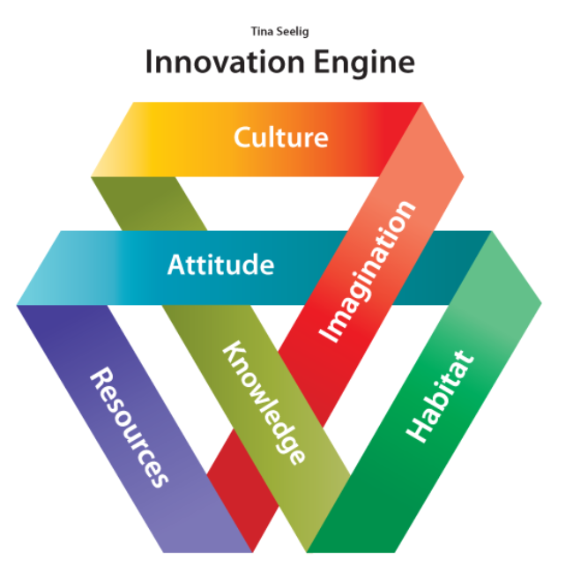

Slide 14
Exercise - imagination
”What is that?”
Notes:
Point and say – What is that?
Look over the shoulder to where I am pointing.
Say – That is a… (not what it is but something creative…)
Train you imagination, fluency…

Slide 15
Exercise - imagination
”The gift…”
Notes:
Wrap a gift – small or large.
Give it to the birthday boy/girl.
Act surprised and say – wow – it is a…

Slide 16
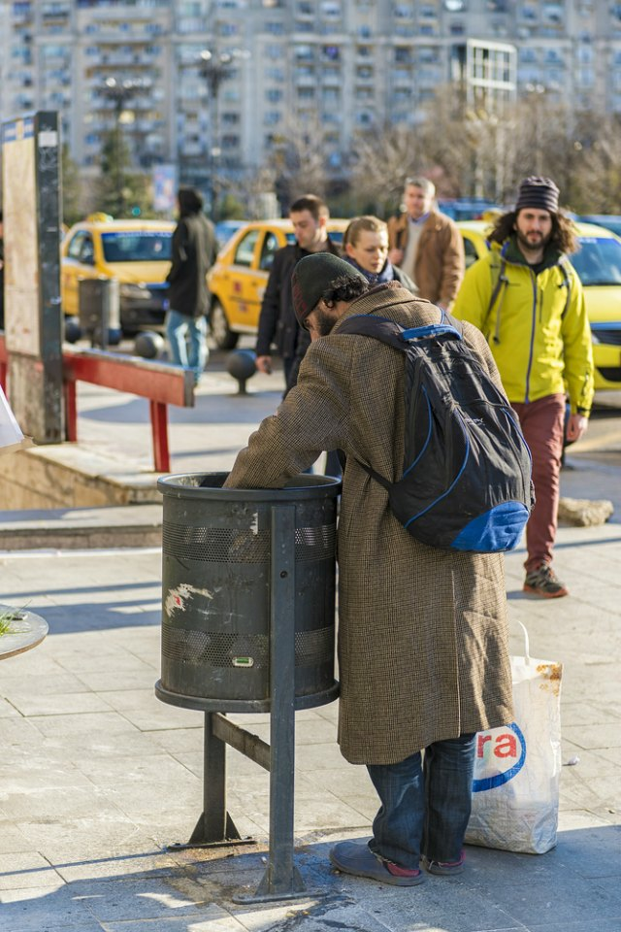
How would you solve this man’s problem?
What is this man’s problem? – frame the problem.
What would a creative solution be?
(no judgement)
Notes:
Looking for empty cans or bottles with a deposit.

Slide 17
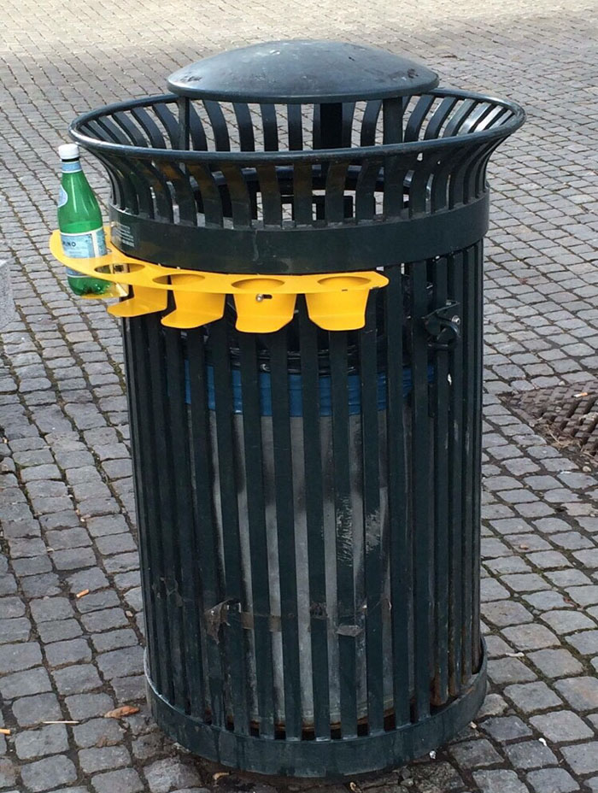
Notes:
Example of creative solution if the man is looking for bottles.

Slide 18
What is creativity?
The four C model of creativity.
Mini C: novel and personally meaningful insight involved in learning and experience
Little C: daily activities
Pro C: professional but not yet eminent
Big C: eminent creativity (extraordinary on another level).

Slide 19
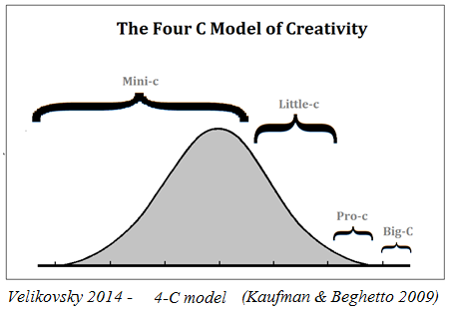
What is creativity?
Definitions
Notes:
Types of creativity: 4C Big C – eminent creativity, Pro C – professional but not yet eminent, Little C – daily activities, Mini C – novel and personally meaningful insight involved in learning and experience
Personal (P-creativity) small – historical (H-creativity) big

Slide 20
What is creativity?
Sampling
Nothing is completely new – everything is a combination of what we already know

Slide 21
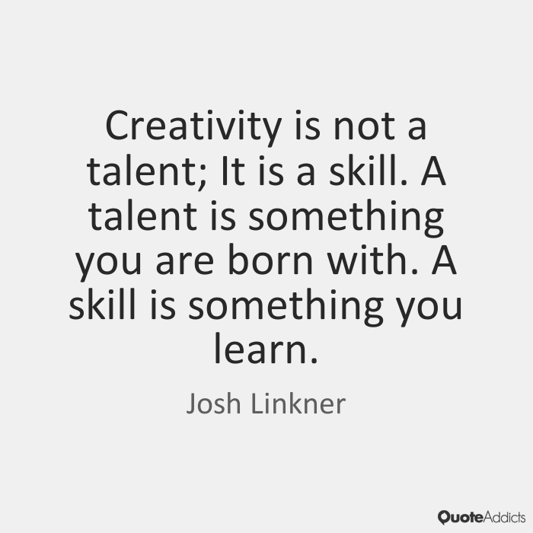
What is creativity?
Born creative?
Is creativity something you either have or don’t have – something you are born with?
Can creativity be learned through training?

Slide 22
What is creativity?
6 Myths of Creativity busted, Amabile (2004)
Creativity comes from creative types
Money is a creativity motivator
Time pressure fuels creativity
Fear forces breakthroughs
Competition beats collaboration
Streamlined org. is a creative organization
Source: Amabile, 2004
https://www.fastcompany.com/51559/6-myths-creativity

Slide 23
What is creativity?
Creativity needs boundaries to work
Constraints, challenges, problems fuel creativity.
Complete freedom does not work to stimulate creativity.
Notes:
“Be creative! – No limits!” – doesn’t work well.

Slide 24
What is creativity?
Is your intelligence going to say something about how creative you are?
a. No there is no correlation.
Source: Mike Dillon, https://youtu.be/jR4jbI3Ds9A
b. Threshold (tærskel) theory:
Experiments show that an IQ over e.g. 86 or 120 is needed for some kinds of creativity – but that high IQ could make people less creative.
Source: https://www.linkedin.com/pulse/do-you-need-intelligent-order-creative-nick-skillicorn/

