Slide 1
Creative and Effective Marketing
What is creativity?

Slide 2
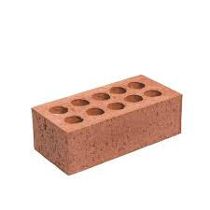
Creative exercise
Come up with as many uses for a:
Brick (in 3 min.)
Could also be: paper clip, razor blade, pencil, rubber band
Notes:
Ideation - fluency, originality, flexibility, elaboration

Slide 3
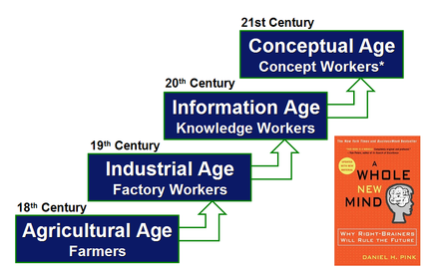
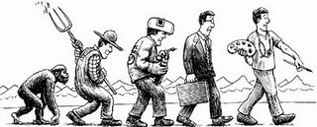
What is creativity?
Notes:
A whole new mind, Daniel Pink, 2005
Summary, 15 min.: https://youtu.be/IZGP99A7vhM?si=hXpW2F83Wtc3ookb
Resume af videoen (lavet af ChatGPT):
*Daniel H. Pink's bog *A Whole New Mind* understreger, at kreativitet bliver stadig vigtigere i den moderne verden. Traditionelt har analytisk og sekventiel, været betragtet som dominerende, men med overgangen fra informationsalderen til en konceptuel verden fremhæves evne at være kreativ, holistisk og fokuseret på det større billede, bliver afgørende for succes.
De vigtigste temaer i bogen omfatter værdien af empati, design, storytelling, leg og mening. Disse færdigheder vil give individer og organisationer en konkurrencefordel, især i en globaliseret verden, hvor automatisering og outsourcing truer med at overtage de mere analytiske opgaver. Pink argumenterer for, at kreativitet og evnen til at se helheder (symphony) nu er nøglen til innovation og tilpasning i en verden, hvor information er let tilgængelig.
Bogen understreger, at færdigheder som storytelling og empati gør det muligt at skabe meningsfulde forbindelser mellem mennesker og produkter, hvilket gør dem tiltrækkende i et marked præget af overflod. Derudover fremhæver den, hvordan leg og humor kan bidrage til bedre trivsel og produktivitet i en kompleks og hurtigt foranderlig verden.

Slide 4
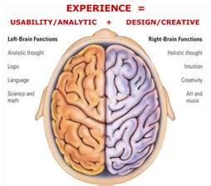
What is creativity?
The creative brain
Creativity is not only happening in the right side of the brain – but in the whole brain.
Notes:
Daniel Pink talks about left and right brain activity.
Creativity is a whole brain activity

Slide 5
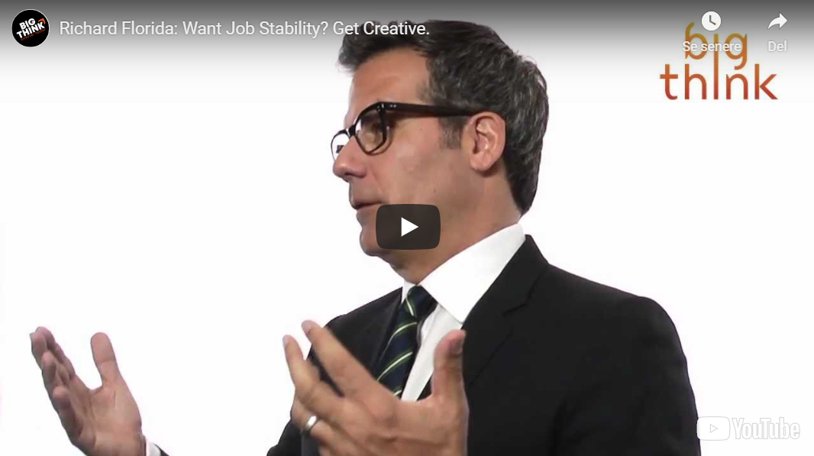
What is creativity? Richard Florida
Want job stability - get creative.

Slide 6
What is creativity?
Creativity and business goes hand in hand.
”In the past,
commercial values (business) and
artistic autonomy (creative) were seen as being in opposition.
But now,
the very best artists (creative) are also some of the most effective entrepreneurs (business)"
Source: Jobber p. 359 (7th edition)

Slide 7
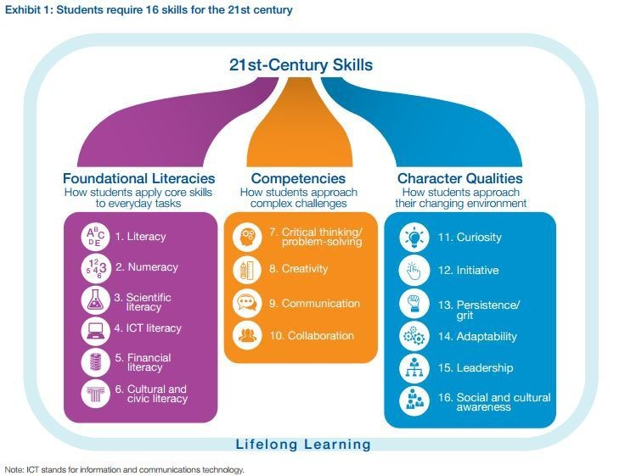
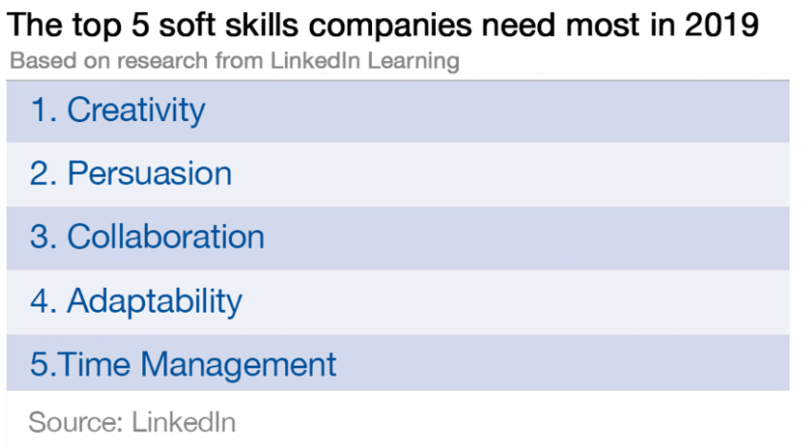
What is creativity?
https://www.weforum.org/agenda/2019/01/the-hard-and-soft-skills-to-futureproof-your-career-according-to-linkedin/

Slide 8
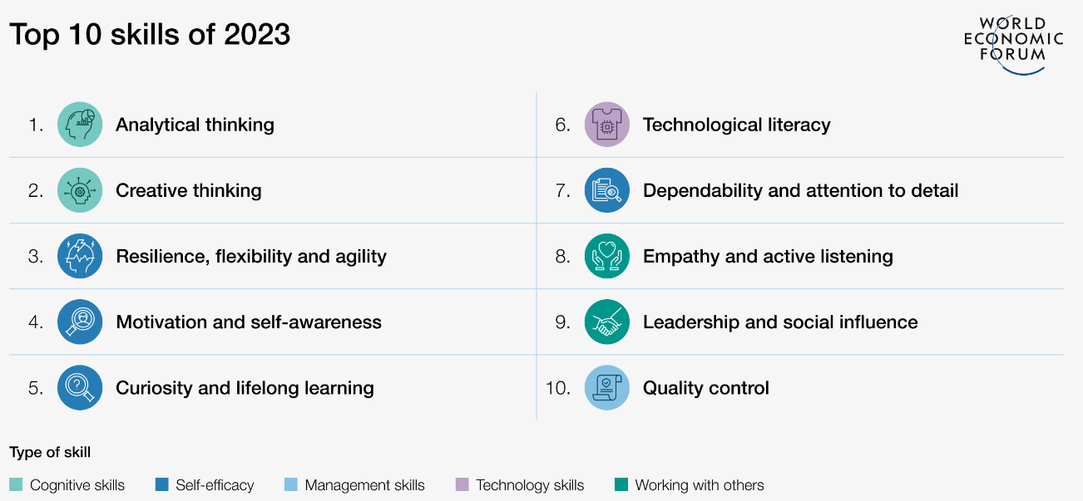
What is creativity?
https://www.weforum.org/agenda/2023/05/future-of-jobs-2023-skills/

Slide 9
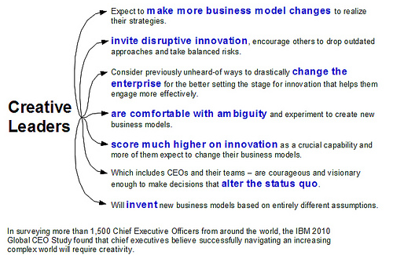

Slide 10
What is creativity?
As we grow older we become inhibited by norms, expectations, socialization, ambitions, fear – schooling, convergent thinking…
We learn to control impulse and give the correct answer…

Slide 11
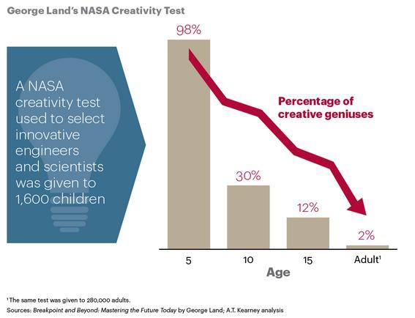
What is creativity?
Video: https://youtu.be/ZfKMq-rYtnc?t=308
Notes:
Divergent/convergent thinking at the same time. Must separate them.
Turn on your imagination.
Fear, logic = use a small part of the brain. Creativity = use big part of the brain.

Slide 12
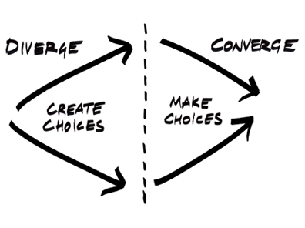
What is creativity?
The creative brain
Divergent thinking and convergent thinking
Notes:
George Land talks about divergent and convergent thinking.
Divergent/convergent thinking at the same time kills creativity. Must separate them.

Slide 13
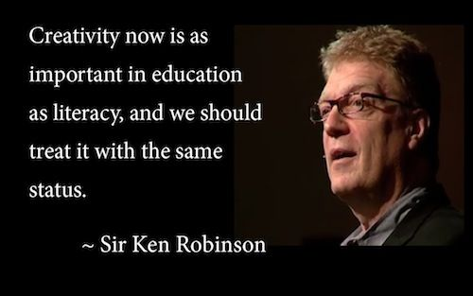
What is creativity? Sir Ken Robinson
https://youtu.be/iG9CE55wbtY?t=184
Notes:
Do schools kill creativity
https://youtu.be/iG9CE55wbtY?t=184
Start 3:04 – slut 6.33

Slide 14
Creative exercise
Ideation – reduce fear of failure, celebrate what you have learned
2 people standing opposite each other.
1: clap your own hands
2: clap each others hands
3: clap you thighs
Put your arms up to celebrate and say ”YES, we failed…”
FAIL = First Attempt In Learning

Slide 15
What is creativity?
How kids lose creativity and what to teach them instead
Creative problem solving
Challenge assumptions
Mistakes are opportunities to learn
Diversity over conformity
Foster imagination and curiosity
Source: Josh Linkner,
http://www.forbes.com/sites/joshlinkner/2014/10/16/how-kids-lose-their-creativity-as-they-age-and-how-to-prevent-it/#8a2e75b16c66

Slide 16
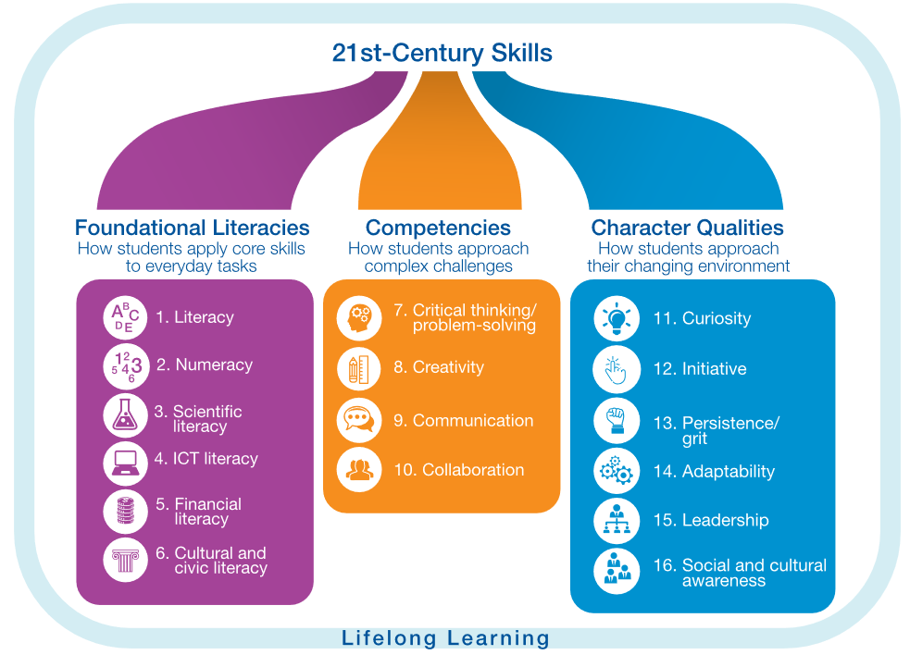
What is creativity?
World Economic Forum, 2016
21 century skills
https://www.weforum.org/agenda/2016/03/21st-century-skills-future-jobs-students/

Slide 17
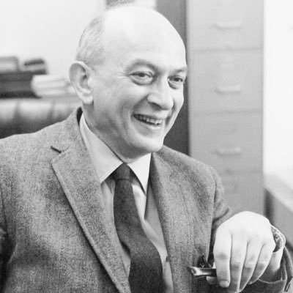
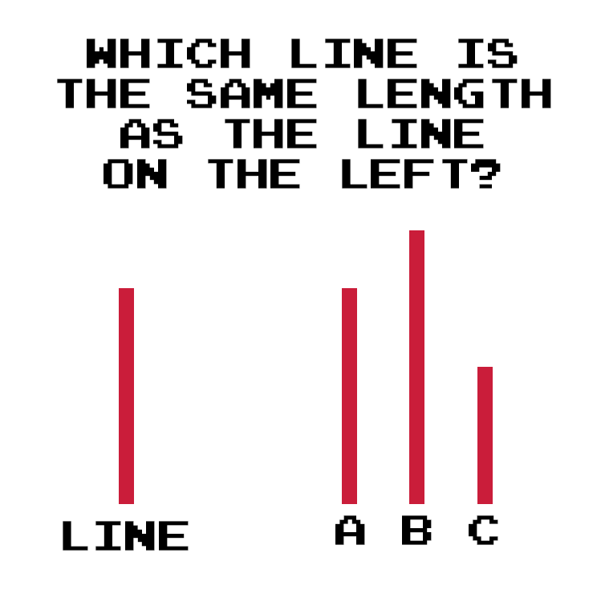
What is creativity? Solomon Asch
Notes:
Salomon Asch: https://www.youtube.com/watch?v=TYIh4MkcfJA
Other conformity experiments:
Waiting room: https://www.youtube.com/watch?v=o8BkzvP19v4
Elevator: https://youtu.be/dDAbdMv14Is

Slide 18
What is creativity?
Impulse control - filtering and preventing ideas from surfacing.
According to Martindale, the frontal lobe is responsible for the inhibition of creative behavior, meaning our natural state is a wildly creative one, but our brains wisely intervene and tone our creativity down so that we may function in day-to-day life.
Martindale’s (1999) theory of cognitive disinhibition

Slide 19

What is creativity? Charles Limb
Notes:
Keith Jarret, Carnegie hall, 2008
https://youtu.be/BomNG5N_E_0

