Slide 1
Creative and Effective Marketing
What is creativity?

Slide 2
Agenda
Creativity – ”Flow”, Mihaly Csikszentmihalyi

Slide 3
What is creativity?
What characterizes some of the best moments in life?

Slide 4
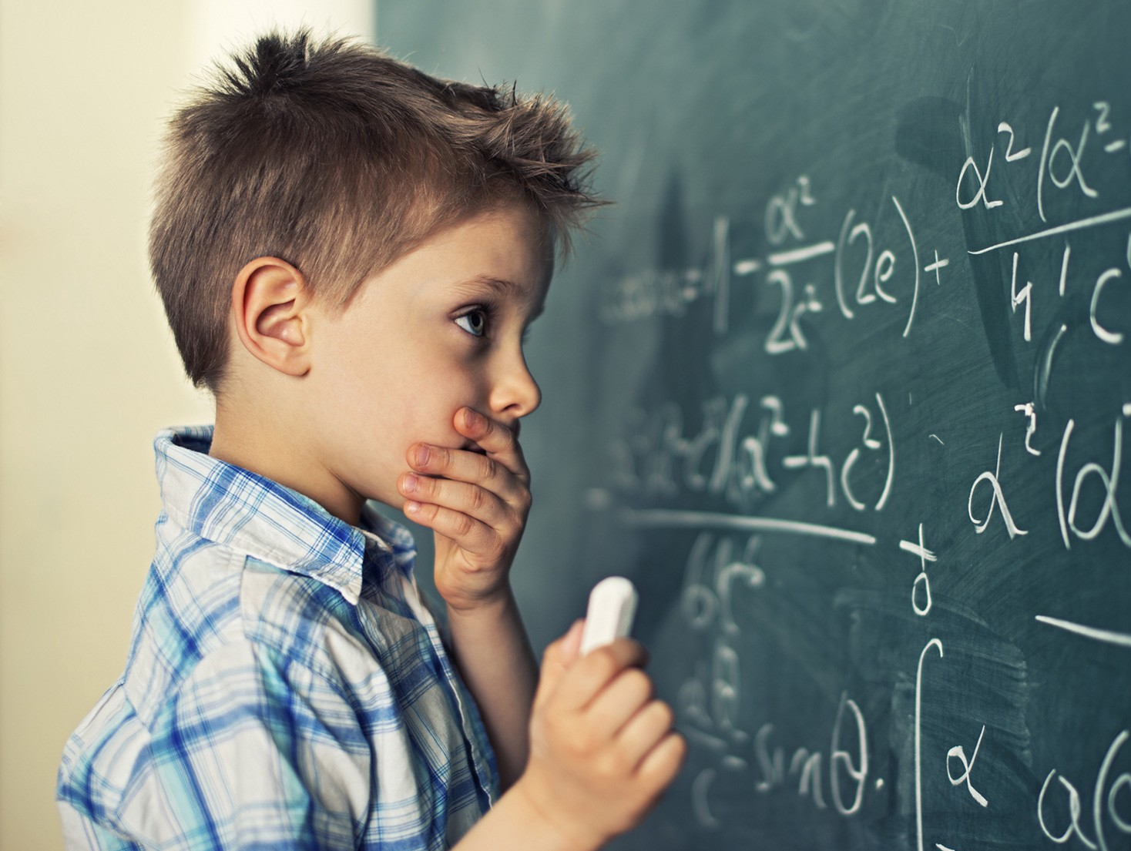
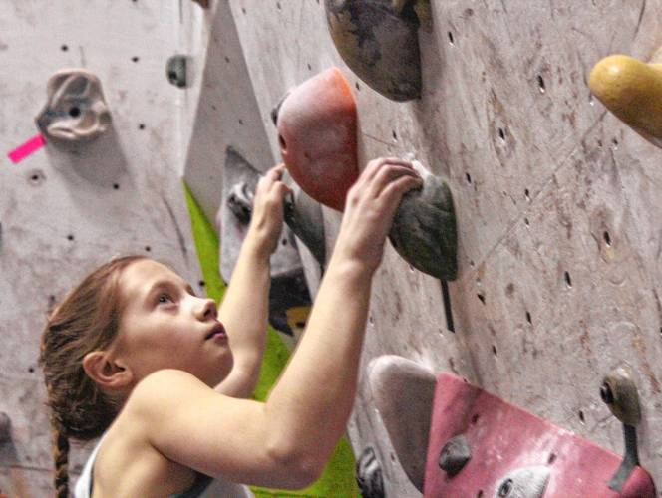
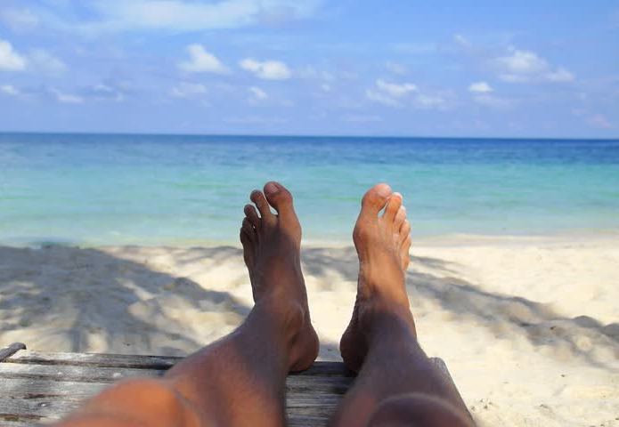

Slide 5
What is creativity?
"The best moments in our lives are not the passive, receptive, relaxing times…
The best moments usually occur if a person’s body or mind is stretched to its limits in a voluntary effort to accomplish something difficult and worthwhile."
Source: Mihaly Csikszentmihalyi (1990, p. 3)

Slide 6
What is creativity?
Mihaly Csikszentmihalyi discovered that people find genuine satisfaction during a state of consciousness called Flow.
In this state they are completely absorbed in an activity, especially an activity which involves their creative abilities. During this "optimal experience" they feel "strong, alert, in effortless control, unselfconscious, and at the peak of their abilities.“
Source: TED talk (start 13.48) https://www.ted.com/talks/mihaly_csikszentmihalyi_on_flow?language=da&utm_source=tedcomshare&utm_medium=email&utm_campaign=tedspread

Slide 7
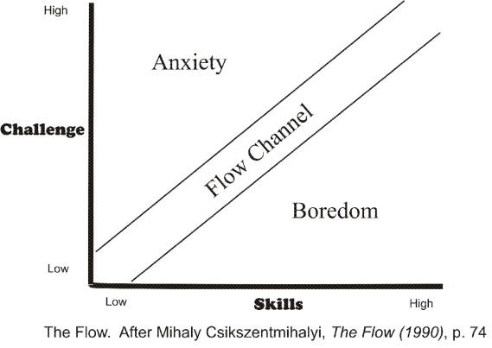
What is creativity?
Notes:
Map din egen tilstand
Hvor ligger du - hvad er dit næste træk? Hvordan kommer du til at opleve mere flow?
Har du oplevet flow?
Csikszentmihalyi har studeret kreative og lykke.
Økonomisk velstand over et minimum øger ikke lykke.
Ekstase - "at stå ved siden af" - ved siden af dagligdags rutiner - en ny virkelighed
Den automatiske proces kan kun ske hvis du er trænet - derfor skal du have 10 års erfaring inden for et felt for at kunne ændre noget til noget bedre end det der var.
Ide - noter når du har været i flow - beskriv det -
Linked to intrinsic motivation!
According to Claremont Graduate University Professor Mihaly Csikszentmihalyi, people have flow when:
They have clear, articulated goals
They get immediate feedback
They take on an achievable but challenging task
They merge their awareness and their actions
They become immersed and undistracted
They have high levels of control and don’t worry about failure
They step outside their own sense of self
They encounter a feeling of timelessness
The activity becomes an end unto itself.
Indsat fra <http://www.globoforce.com/gfblog/2013/happiness-flow-and-how-to-be-a-better-leader/>
He describes five ways that we can cultivate our own flow:
Set goals that have clear and immediate feedback
Become immersed and focused on a particular activity
Pay attention to what is happening in the moment
Learn to enjoy immediate experience
Proportion your skills to the challenge at hand
Indsat fra <http://www.globoforce.com/gfblog/2013/happiness-flow-and-how-to-be-a-better-leader/>

Slide 8
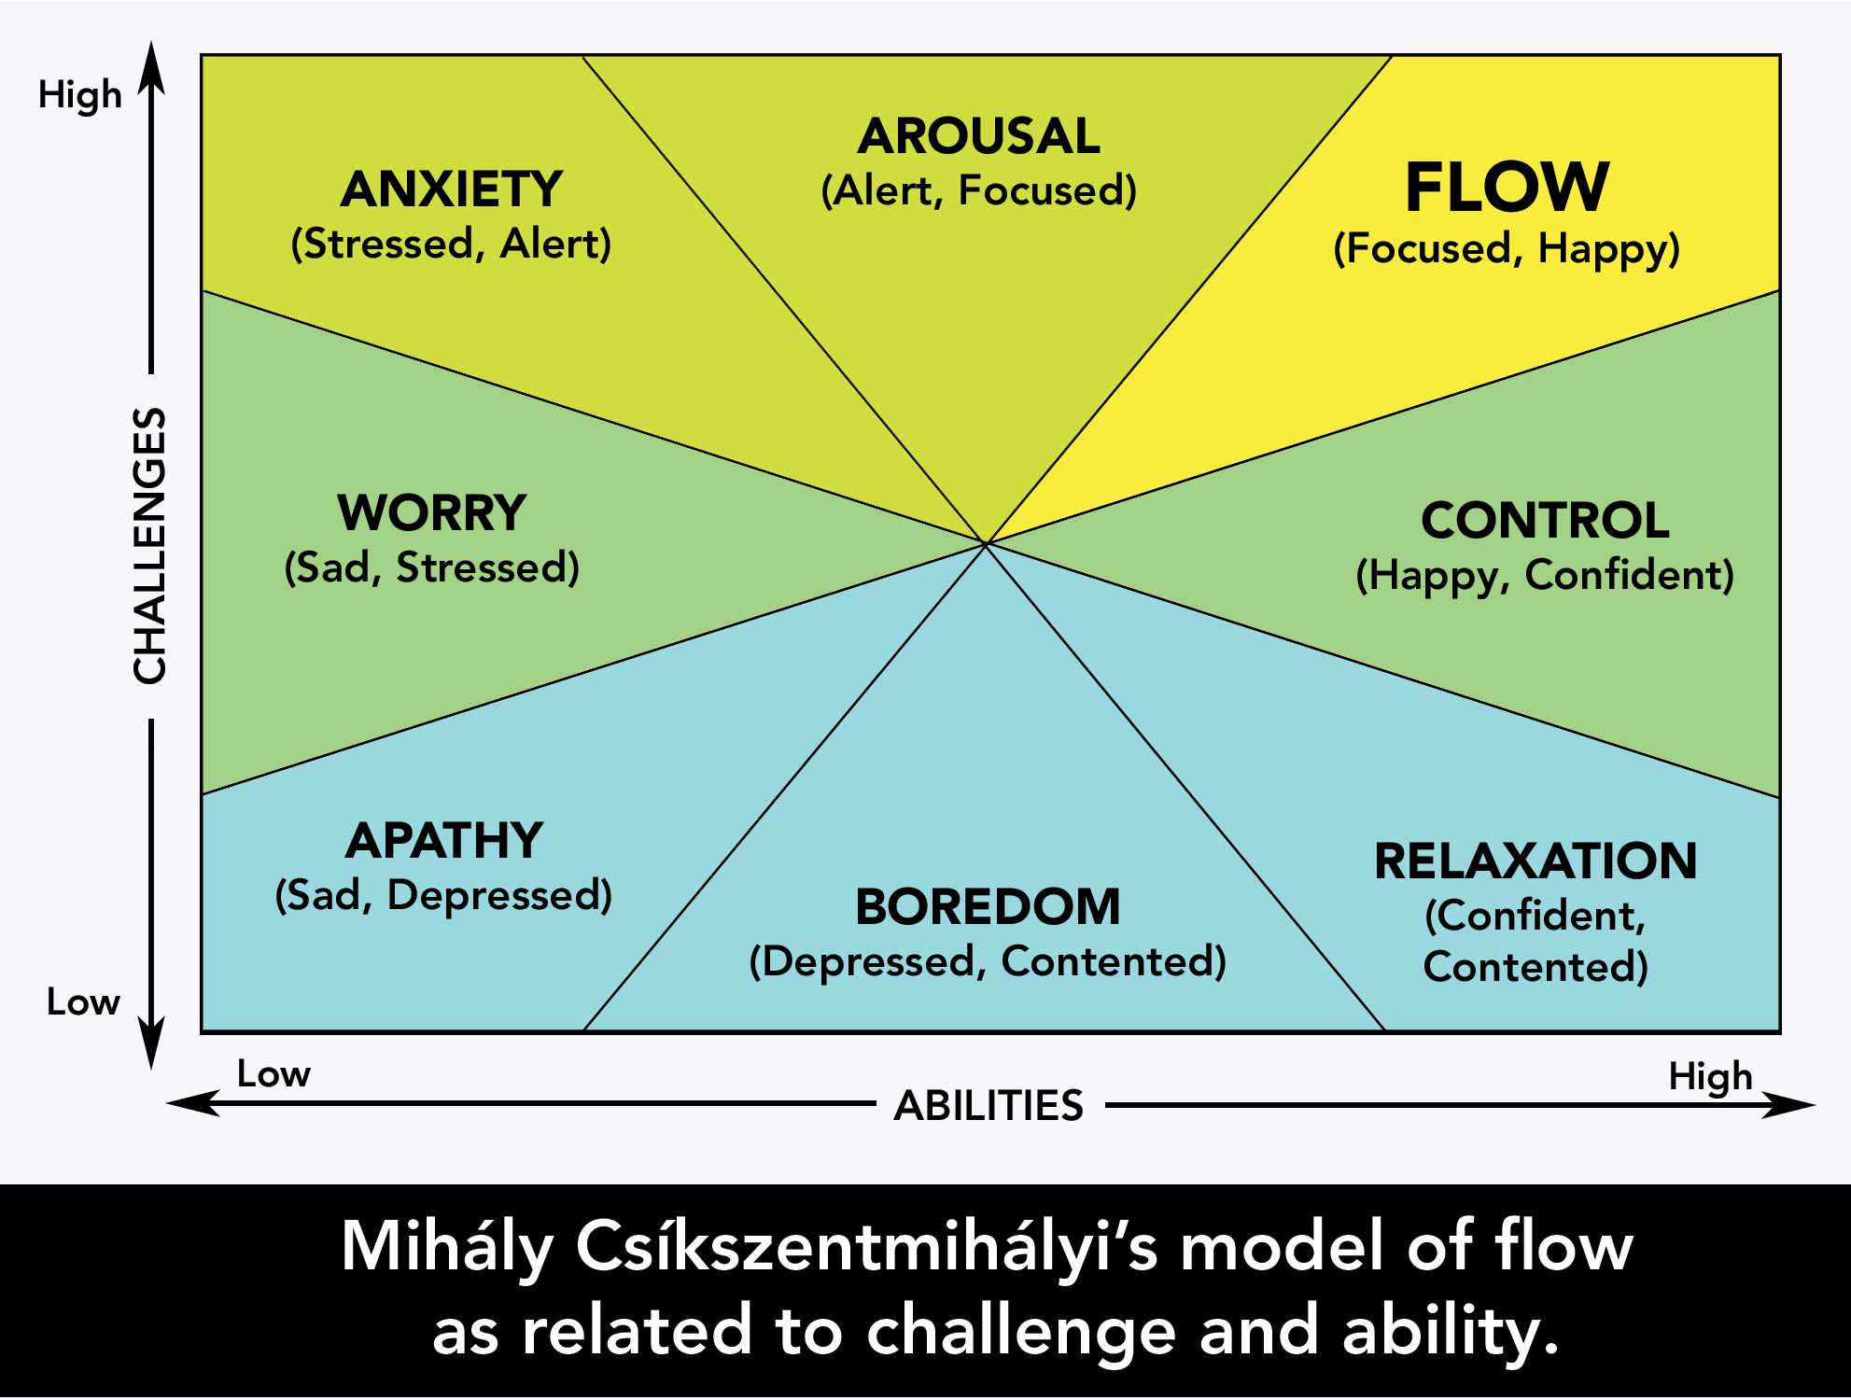
What is creativity?

Slide 9
What is creativity?
According to Mihaly Csikszentmihalyi, people have flow when:
They have clear, articulated goals
They get immediate feedback
They take on an achievable but challenging task
They merge their awareness and their actions (intuitive)
They become immersed and undistracted
They have high levels of control and don’t worry about failure
They step outside their own sense of self
They encounter a feeling of timelessness
The activity becomes an end unto itself.
http://www.globoforce.com/gfblog/2013/happiness-flow-and-how-to-be-a-better-leader/

Slide 10
What is creativity?
He describes five ways that we can cultivate our own flow:
Set goals that have clear and immediate feedback
Become immersed and focused on a particular activity
Pay attention to what is happening in the moment
Learn to enjoy immediate experience
Proportion your skills to the challenge at hand
http://www.globoforce.com/gfblog/2013/happiness-flow-and-how-to-be-a-better-leader/>

Slide 11
What is creativity?
Map you own state
Where in the model are you often, rarely, never?
Have you experienced ”flow”?
When do you experience ”flow”?
How can you experience more ”flow”?

