Slide 1
Creative and Effective Marketing
How to develop creativity?

Slide 2
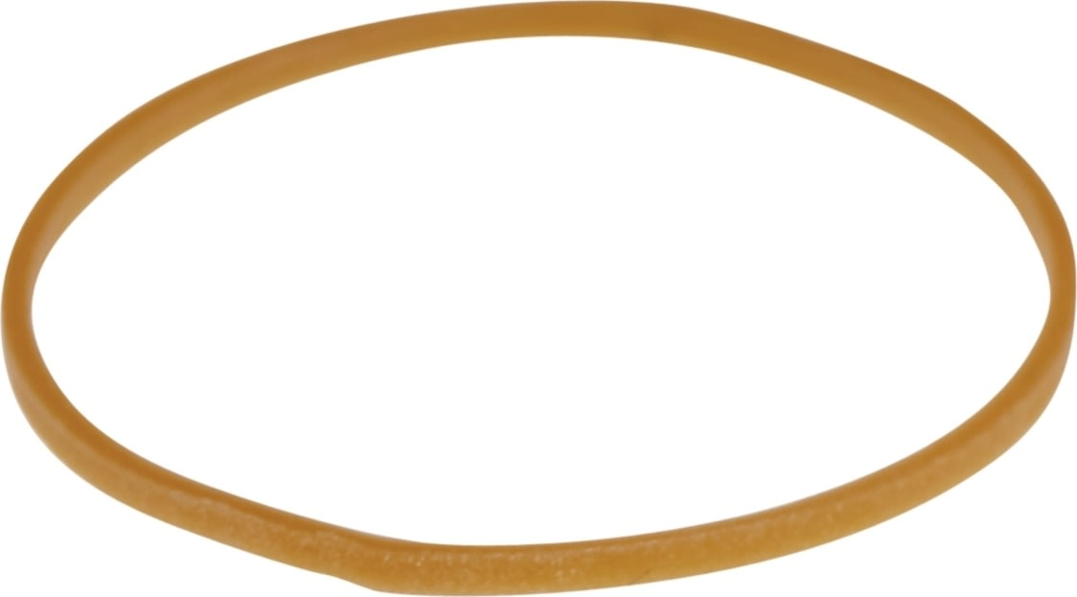
Creative exercise
Come up with as many uses for a:
Rubber band (in 3 min.)
Could also be: paper clip, razor blade, pencil, rubber band
Notes:
Ideation - fluency, originality, flexibility, elaboration

Slide 3
How to develop creativity?
Byrge & Hansen – “Enhancing creativity for individuals, groups and organizations”
The Creative Platform:
Four fundamental principles for practicing creativity:
Horizontal thinking - apply all knowledge across existing patterns of thought - knowledge not directly related to the problem
Task Focus – focus on task, nothing else
Parallel thinking – the whole team focus on the same
No judgement - not having the feeling of being judged by oneself or others.
A key is doing instead of thinking.

Slide 4
How to develop creativity?
Clayton M. Christensen – “The Innovaters DNA”
In The Innovator's DNA, the authors identify five capabilities demonstrated by the best innovators:
(1) Associating: drawing connections between questions, problems, or ideas from unrelated fields
(2) Questioning: posing queries that challenge common wisdom
(3) Observing: scrutinizing the behavior of customers, suppliers, and competitors to identify new ways of doing things
(4) Experimenting: constructing interactive experiences and provoking unorthodox responses to see what insights emerge
(5) Networking: meeting people with different ideas and perspectives

Slide 5

How to develop creativity?
Tina Seeling – Innovation Engine
Watch video: https://youtu.be/gyM6rx69iqg
Notes:
https://youtu.be/gyM6rx69iqg

Slide 6
How to develop creativity?
Can we measure creativity?
Torrance Test of Creative Thinking (TTCT)
Creative thinking skills – measure fluency, flexibility, originality, elaboration, risk taking, complexity, curiosity, imagination
Fluency – how many uses you can come up with (for a paperclip)
Originality – how uncommon those uses are (e.g. “router restarter” is more uncommon than “holding papers together”)
Flexibility – how many areas your answers cover (e.g. cufflinks and earrings are both accessories, aka one area)
Elaboration – level of detail in responses; “keeping headphones from getting tangled up” would be worth more than “bookmark

Slide 7
Creative exercise
Part of Torrence test
Draw incomplete figures, give a title.
Fluency: how many relevant ideas you have (out of the 9 - speed)
Flexibility: number of categories your ideas fit into (9 airplanes?)
Originality: how uncommon your drawing is (interesting, surprising!)
Elaboration: how detailed your drawing is
Resistance to Premature Closure: how open minded your drawing is, this measures curiosity
Abstractness of Titles: how original your title is (“Brad Pitt’s Mansion” would score higher than “House”), this measures synthesis and organization
7 min. individual exercise.

Slide 8

Creative exercise
”Thirty Circles Test”
5 min. individual exercise.
Notes:
Same as incomplete figures.

Slide 9
Creative exercise
Ideation – build on ideas / never kill ideas…
Say ”yes…and…”
Version 1
Person 1 says ”I think we should all…”
Person 2 says ”No – I don’t think so”
Version 2
Person 1 says ”I think we should all…”
Person 2 says ”Yes – and…”

Slide 10
Creative exercise
Ideation - Imagination
What is happening in this picture?
Write a small story

Slide 11
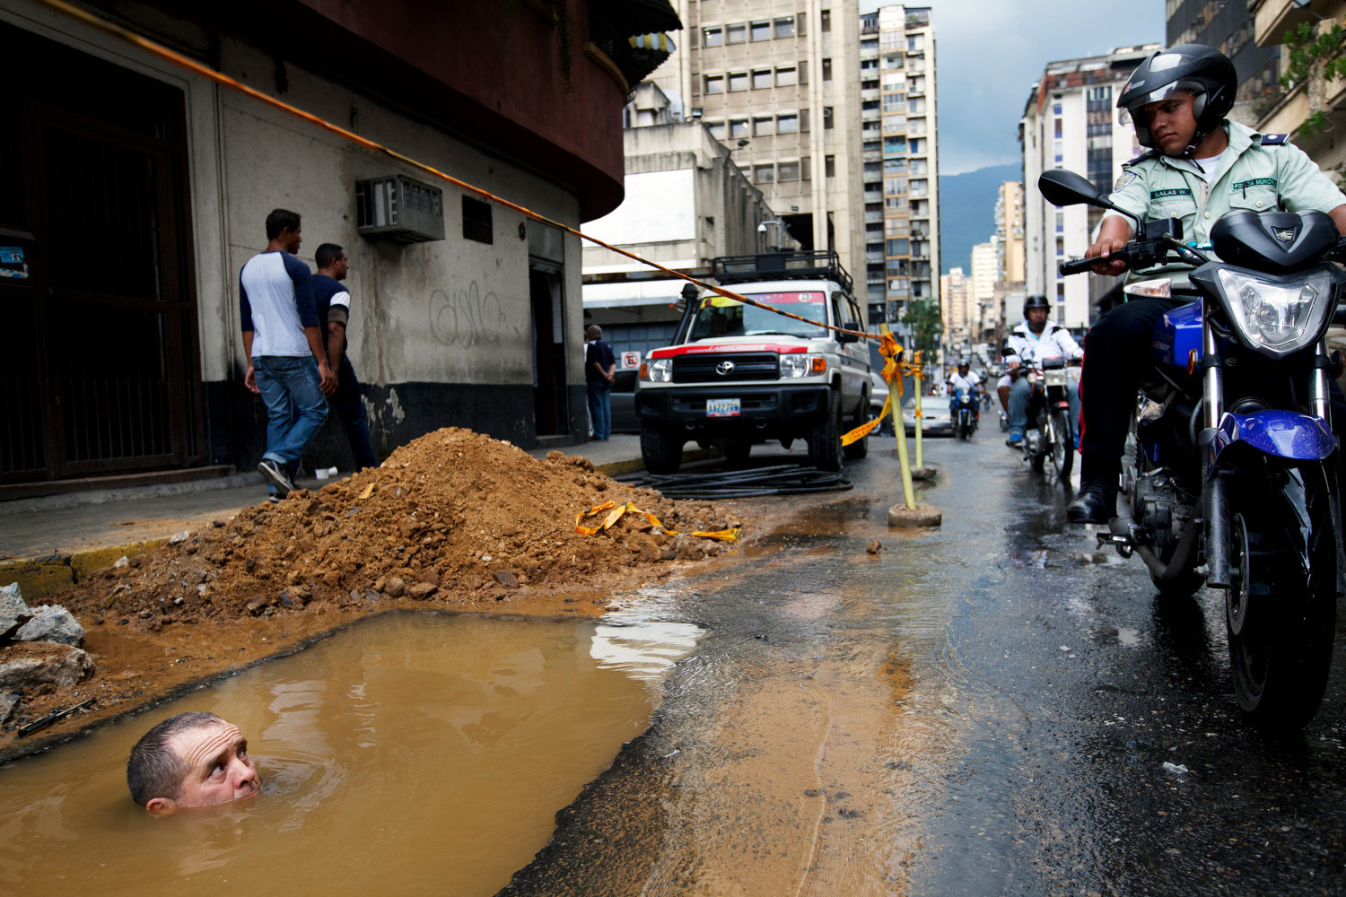

Slide 12
Creative exercise
Ideation – association…
Word association
One person says a word.
The next person quickly says the first thing that comes into mind and so on…

Slide 13
Creative exercise
Ideation – association, combining, trust the process…
Think of the word – ”bubble (boble)” – 1 min.
Write down words you associate with ”bubble (boble)” – 1 min.
Share your words with one other person – 3 min. (get inspired to make more words)
Pick 5 words – write sentences containing each word – 2 min.
Add human emotion, characteristics, colour etc. to your sentences – 2 min.
Write a poem for Bubble using the sentences – 2 min.
Objective: surprise, play, experiment…

Slide 14
Creative exercise
Do something different…
Write down 5-10 things you normally do.
Decide to ”do something different”
Come up with alternative things you can do… and do it before next week.
Objective: be conscious, change habits, experience the world…

Slide 15
Creative exercise
Ideation – free association, improvisation, reduce fear of judgement and failure, increase creative confidence
Half the class:
Move around in different positions – when I say ”freeze” you freeze in a certain position.
Say: ”What are YOU doing?”
Improvise an answer…

Slide 16
Creative exercise
Ideation – combining ideas, presenting ideas…
Pick an object each
Combine the objects
Promote your invention

Slide 17
Creative exercise
Ideation – abstract association
What is the principle behind:
A chair, a car, a T-shirt, a toaster…
Write down 5 other things.
What is the principle behind each thing you wrote down? Write it down.
Combine two principles into a new product/service. Write down and share.

Slide 18
How to develop creativity?
The following slides are meant as “a point of departure” for your study on “How to develop creativity?”
David Kelley - Creative confidence
https://youtu.be/16p9YRF0l-g
Tom Kelley - The art and practical science of creativity
https://youtu.be/zWfj_LfgrfY
Steven Johnson – Where good ideas come from
https://youtu.be/0af00UcTO-c
https://youtu.be/NugRZGDbPFU

Slide 19
How to develop creativity?
Tina Seeling
https://youtu.be/CgCdsERkqrc
Csikszentmihalyi – 5 ways to cultivate flow
https://www.ted.com/talks/mihaly_csikszentmihalyi_on_flow?language=da#

Slide 20
How to develop creativity?
Paul sloane - Are You Open Minded?
https://www.youtube.com/watch?v=4vgl3v8rjj8
Todd Henry - Creativity Under Pressure
https://youtu.be/7hWRva_sPeE
Raphael DiLuzio - 7 steps of creative thinking
https://www.youtube.com/watch?v=MRD-4Tz60KE
Adam Grant – surprising habits of original thinker
https://youtu.be/fxbCHn6gE3U

Slide 21
How to develop creativity?
Nick Skillicorn - How to become more creative
https://youtu.be/y44GBM99JOA
Training program
https://www.ideatovalue.com/become-even-creative-elearning-videos/ (sign up on “idea to value” to get access)
Top 3 dimensions of innovation
http://www.improvides.com/top-3-dimensions-of-innovation/
Imagination
https://www.ideatovalue.com/crea/melissaalles/2016/04/10-surprising-ways-develop-imagination/

Slide 22
”There is not only one reality…
…there are multiple realities”

Slide 23
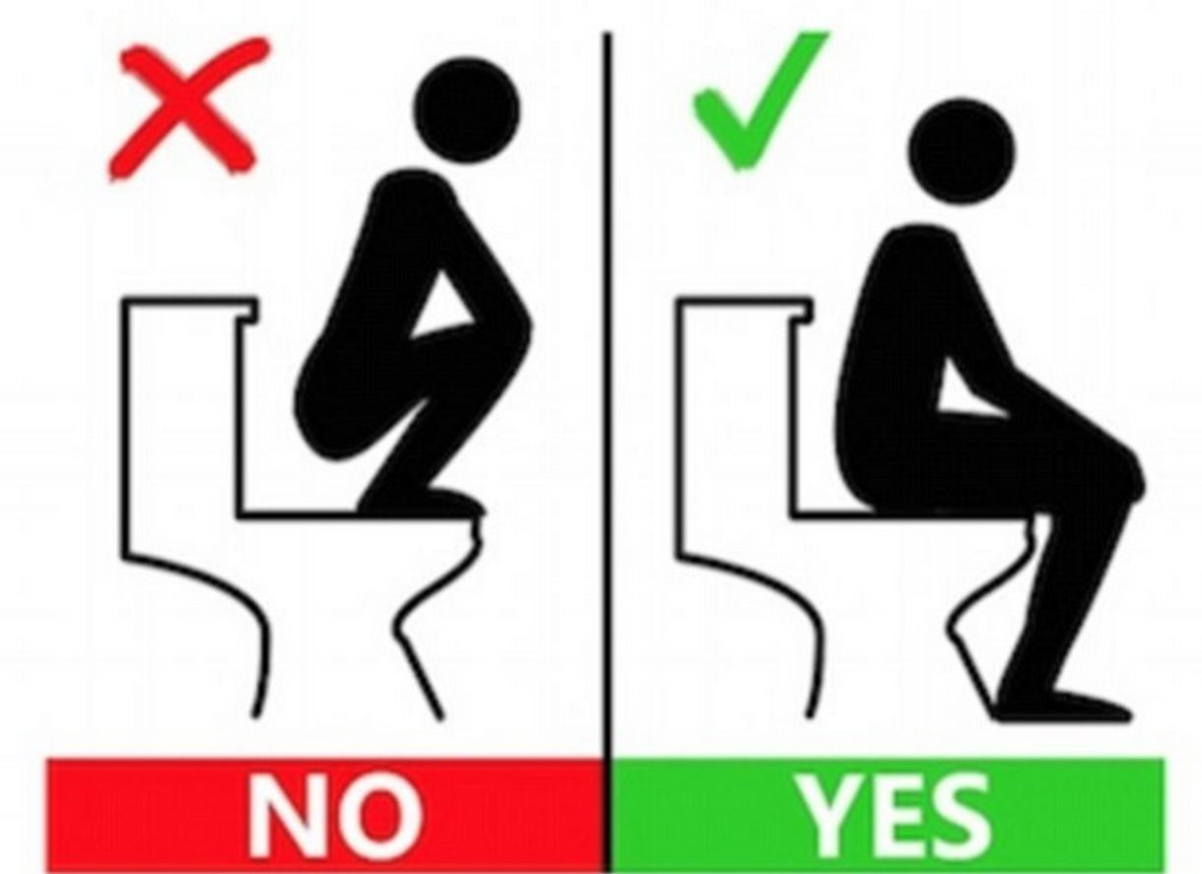

Slide 24

Creative exercise
”You have 2 min. to notice everything green”
Notes:
Hvorfor får vi de ideer vi gør?
Baggrundstilstand:
Her er baggrundstilstanden at lægge mærke til grøn og sortere andre farver fra fordi de ikke er vigtige.
Selection bias
Confirmation bias

Slide 25
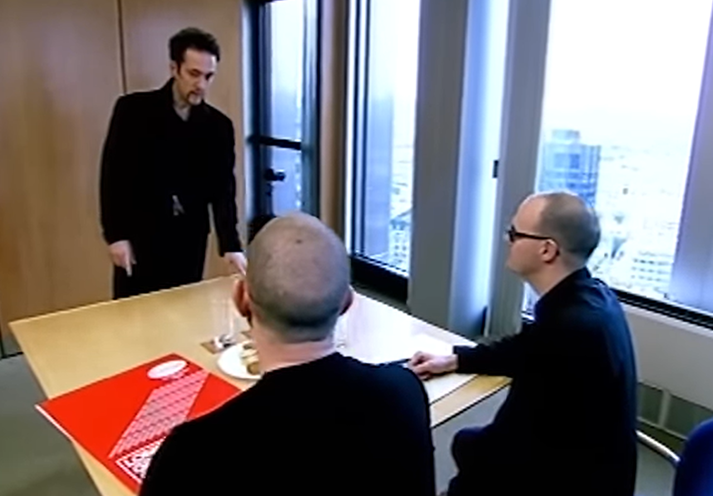
Creative exercise
Advertisers susceptible to subliminal persuasion
Notes:
Hvorfor får vi de ideer vi gør?
Recency bias
https://youtu.be/43Mw-f6vIbo?si=zLS05JmKZA4Zy7oR

