Slide 1
Creative Marketing and Entrepreneurship
Creative processes

Slide 2
Question #2
“What does your creative process look like?”
Present: Friday 15 November (week 46) + on portfolio

Slide 3
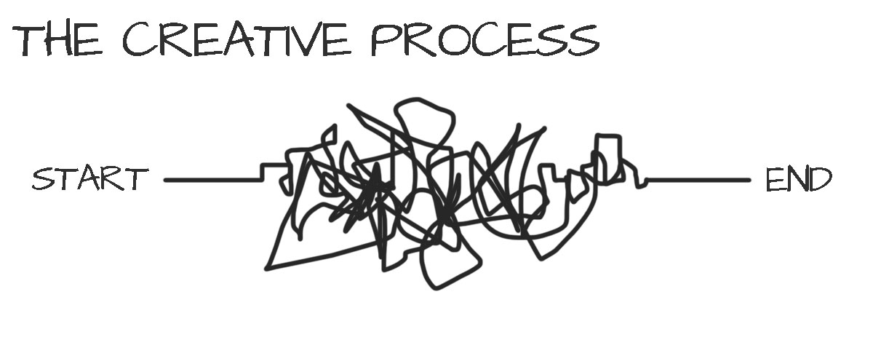
Notes:
Magic. Mystery. Chaotic.
Impossible to control or repeat or improve.

Slide 4
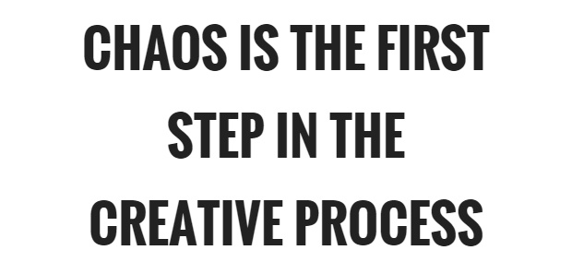
Notes:
Reduce chaos.

Slide 5
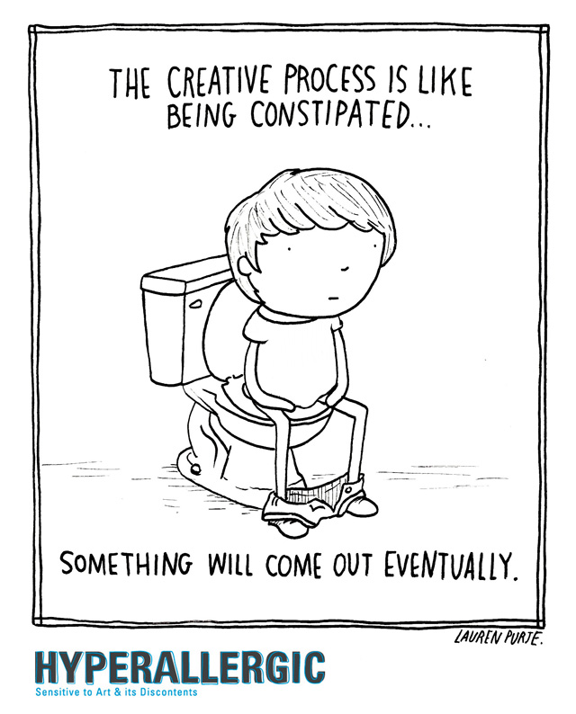
Notes:
Overcome blocks.

Slide 6
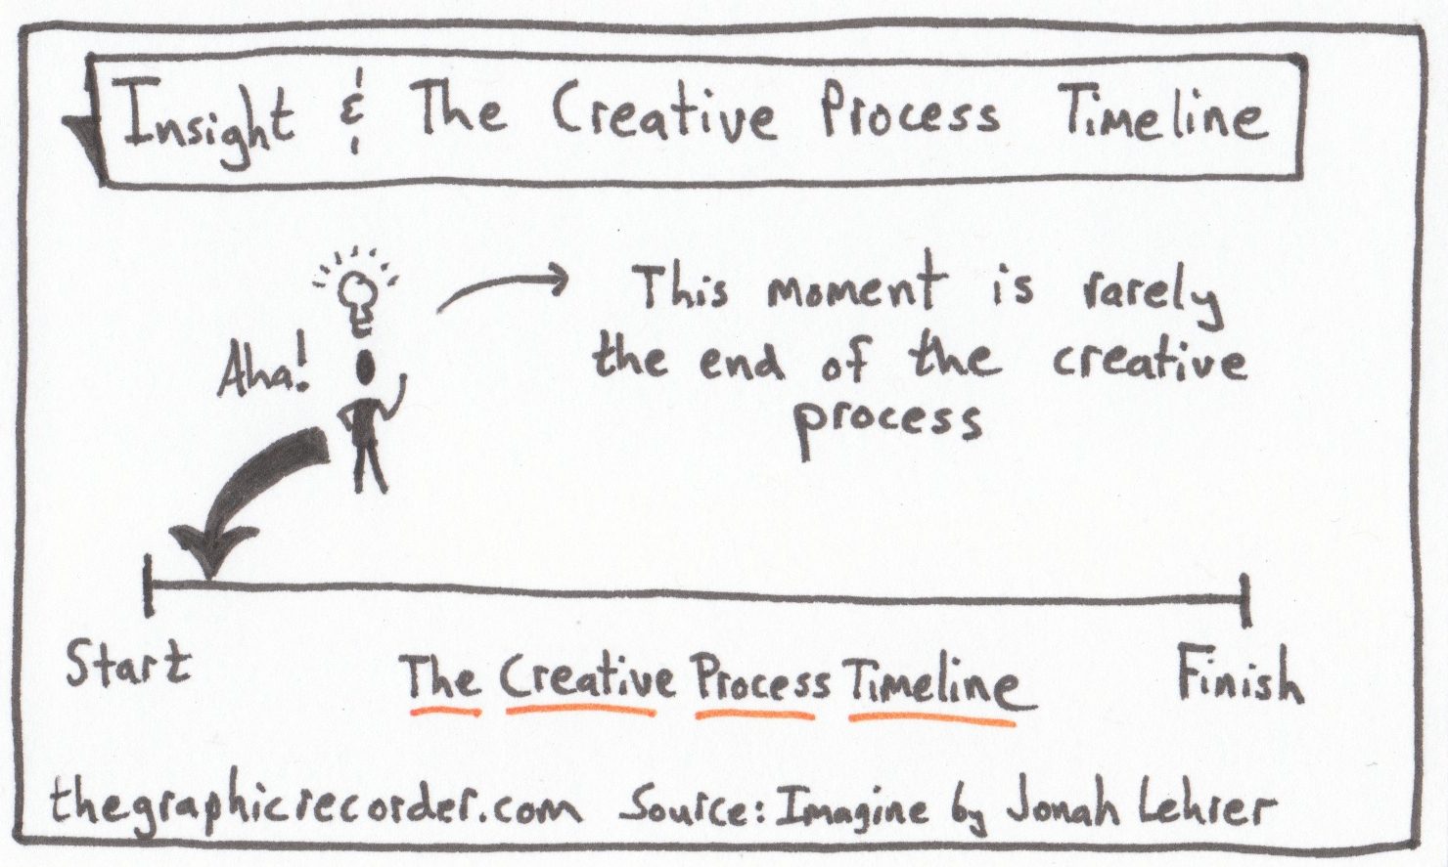
Notes:
Premature finish.

Slide 7
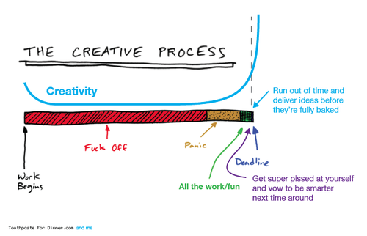
Notes:
Time management - half baked solutions

Slide 8
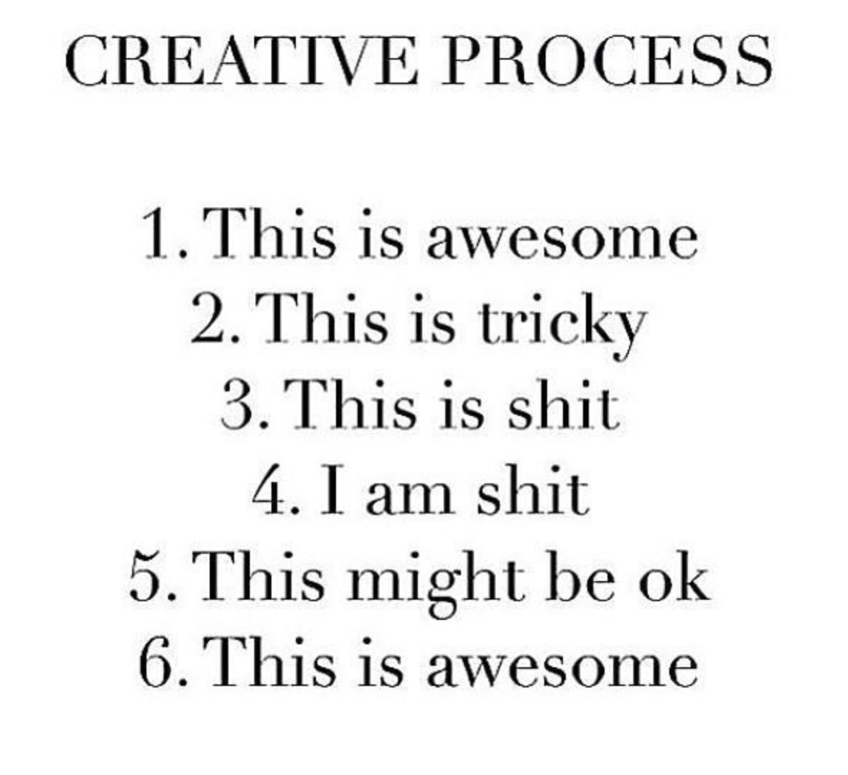
Notes:
Emotional roller coaster

Slide 9
Creative processes
How to structure the creative process so you can produce the most original and effective ideas – again and again – without killing yourself while doing it.

Slide 10
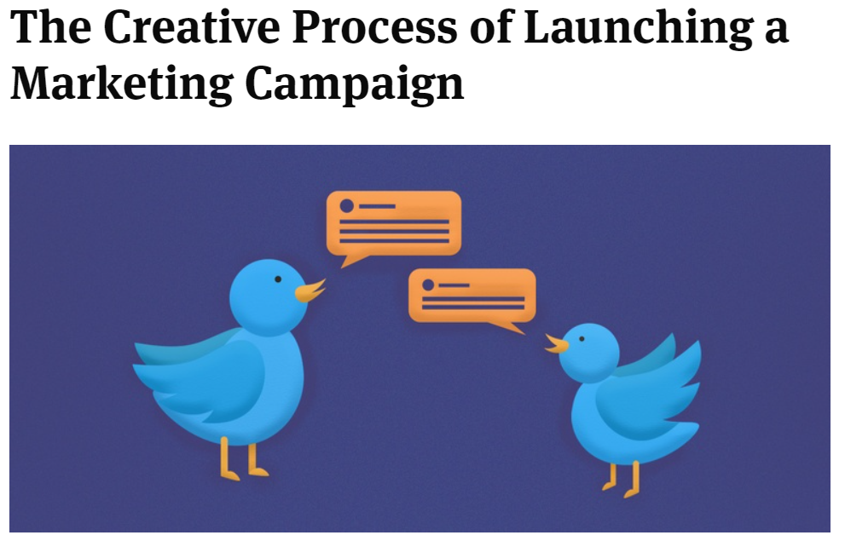
Notes:
https://www.socialmediatoday.com/news/the-creative-process-of-launching-a-marketing-campaign/527365/

Slide 11
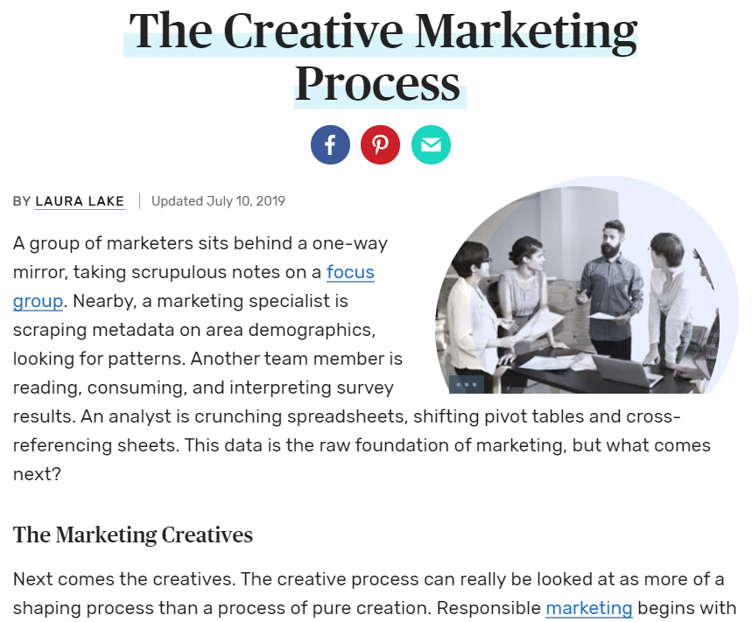
Creative processes
Notes:
https://www.thebalancesmb.com/creative-marketing-who-what-how-3989903

Slide 12
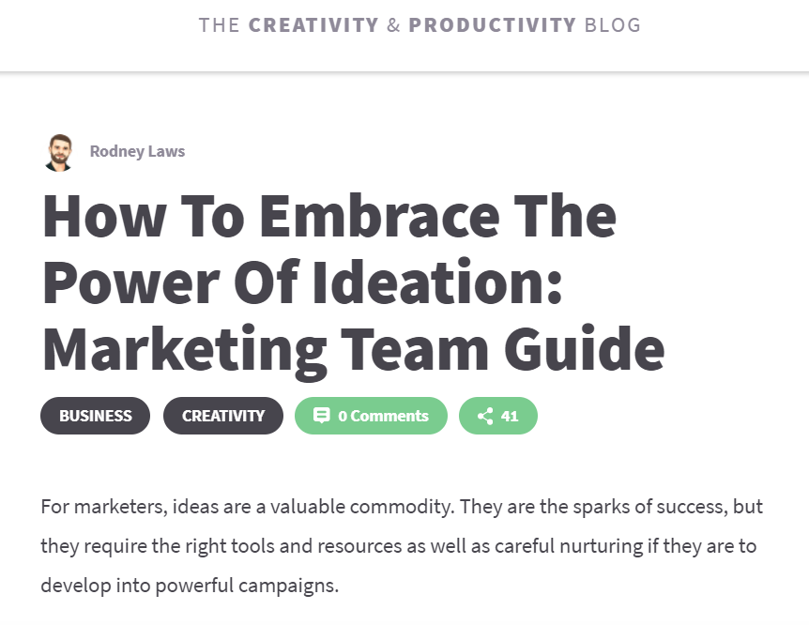
Notes:
https://www.mindmeister.com/blog/how-to-embrace-the-power-of-ideation-marketing-team-guide/

Slide 13

Notes:
https://www.fusingcreativity.com/ideation/

Slide 14
Creative processes
Answer questions like:
Who are involved in the creative process?
Who is responsible for the creative process?
What are the steps in the creative process?
What is a creative brief?
How are processes different/similar?
…
Notes:
Brief

Slide 15
Creative processes
Working with clients
Typical process?
Creative brief by client
Creative process starts: Research, set goals, ideate, test…
Pitch solution to the client
Creative process continues: Develop concept, plan campaign, make mediaplan…
The client buys the solution – and launches.
Notes:
Brief

Slide 16
Creative processes
Who is involved in the process?
Creative director, copywriter, graphic designer, videographer, data analyst, market researcher…

Slide 17
Creative tools
For each phase in the creative process there are creative tools that you can use:
Tools for gathering insights/information
Tools for framing the right question
Tools for creating original ideas
Tools for selecting and prototyping ideas
Tools for testing ideas…
Make sure you know the difference between process and tools.

Slide 18
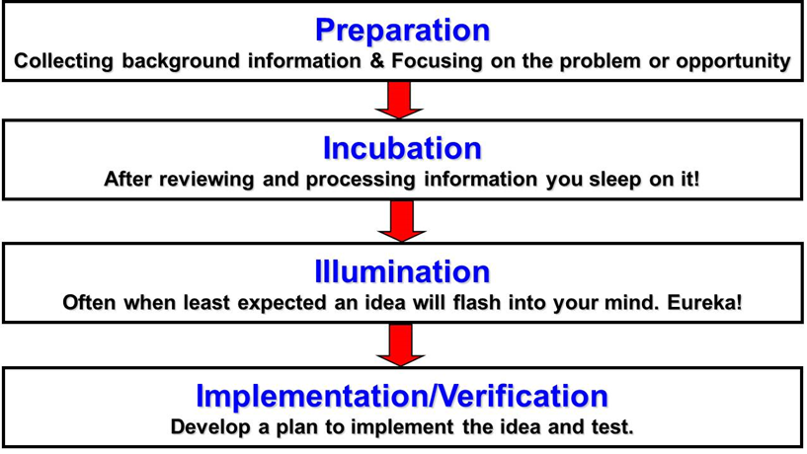
Creative processes
Graham Wallas (1926)

Slide 19
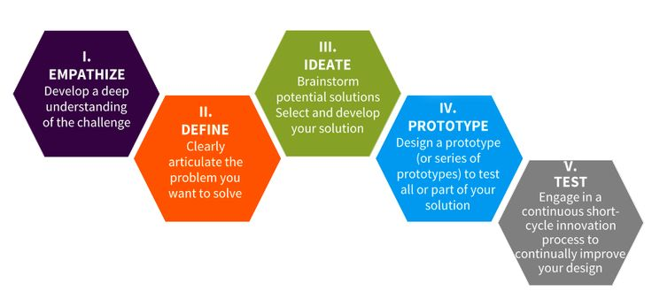
Creative processes
Design thinking, IDEO, Stanford D-School (1991)
Notes:
Design thinking dates back to beginning of 1960’s. And build on creativity tools from the 1950’s.
Bootleg PDF

Slide 20
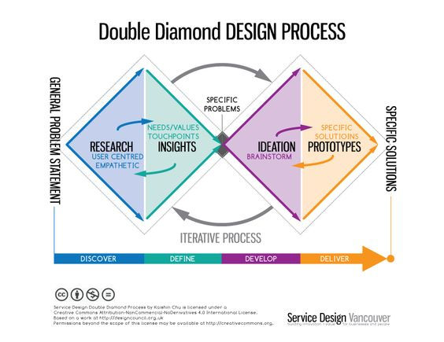
Creative processes
British Design Council 2005
Notes:
Working on asking the right question – discover and define
Working on the right solution – develop and deliver

Slide 21
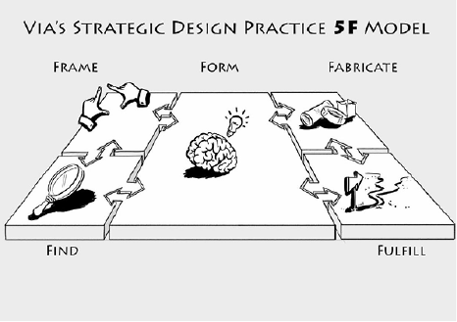
Creative processes
Notes:
VIA strategic design practice
https://youtu.be/uOo2ynlEsFU
+ PDF

Slide 22

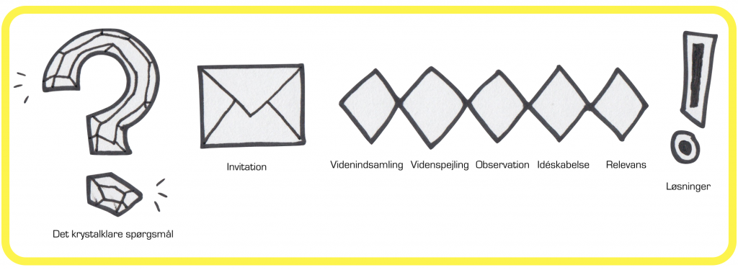
Creative processes
Carsten Borch (2014)
Crystal clear question
Knowledge gathering
Knowledge mirroring
Observation
Idea generation
Relevance of solution

Slide 23
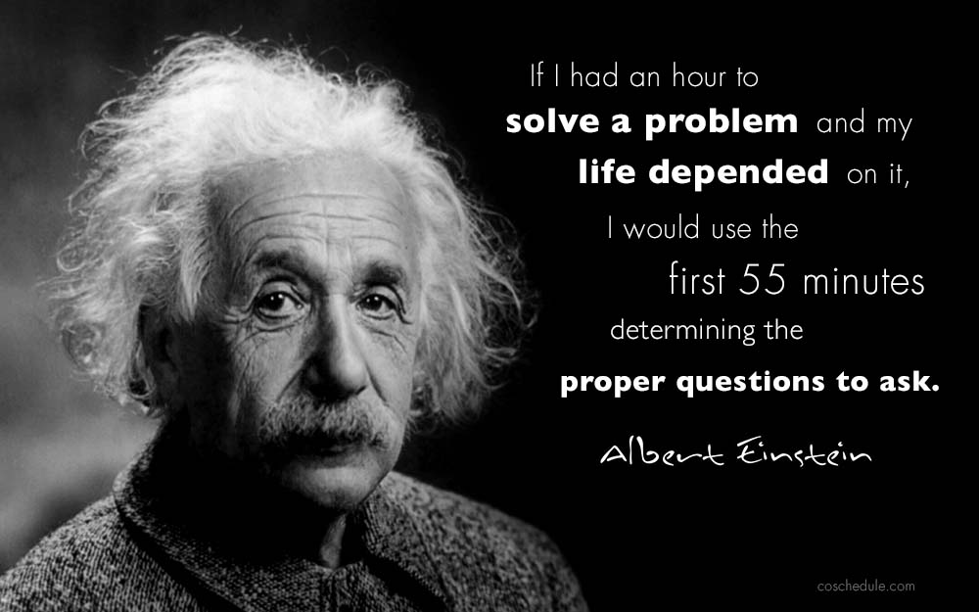
Notes:
Problem – my team is not working efficiently together.
Q: How can I help my team be a better team?
Q: Why is my team not already a good team?
Q: What are the strengths of each team member that the team can use better?
Q: What does each team member think it takes to be a better team?
Q: What exactly is it my team needs to do to be efficient?
…
Problem - people think the elevator is slow
Q: how can we make it faster
Q: how can we make the waiting time more fun and pass faster

Slide 24
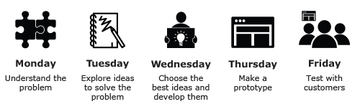
Creative processes
Google Venture Design Sprint (5 day)
The process we use

Slide 25
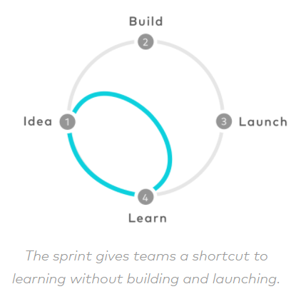
Creative processes
Google Venture Design Sprint (5 day)

Slide 26

Creative processes
Google Venture Design Sprint
Short intro
https://www.thesprintbook.com/the-design-sprint
Summary
https://youtu.be/AuktI4lBj6M
The full course:
https://www.thesprintbook.com/the-design-sprint
https://www.gv.com/sprint/

Slide 27
What you have to do
Come up with a creative solution to the problem presented in the creative brief.
Use GV Design Sprint step by step from “Set the stage” to “Friday” to come up with the solution.
Pitch your creative solution to the client.
Notes:
You should have the ability to work with the process. Because then you can:
facilitate the creative process for a creative team or
make creative work in your own team.

Slide 28
What you have to do
You should document the creative process (GV design sprint) you go through in the work you do for Bubble.
Add your documentation to your presentation of question 2: “What does your creative process look like”.
You should:
Show your map + research (Monday)
Show your solution sketches (Tuesday)
Show your storyboard (Wednesday)
Show your prototype (Thursday)
Show results of your test (Friday)
Example of how to document the creative process step by step: https://youtu.be/AIpjJxDbAx0

